Slide 1
AI-Based Exam Cheating Detection System Using Computer Vision
LORDS INSTITUTE OF ENGINEERING AND TECHNOLOGY (AUTONOMOUS) · DEPARTMENT OF CSE (AI&ML)
Major Project Phase-1 (Review-2) · Team JAAI · CSE-AIML 4A · 2026–27
Team Members
Awais (160923748038) · Jameel Ali (160923748039)
Arif (160923748055) · Ibrahim (160923748059)
Guide: Mr. Dr. Altaf .C, [AHoD]

Slide 2
Table of Contents
01
Abstract
02
Introduction
03
Overview
04
Literature Survey
05
Existing System & its Disadvantages
06
Proposed System & its Advantages
07
System Architecture
08
Modules
09
Algorithms
Smart Surveillance System · Major Project Phase-1 · Review-2
2

Slide 3
Abstract
The proposed system is an AI-based computer vision application that assists in monitoring examinations through CCTV or webcam video. It analyses student activity frame by frame and identifies a focused set of predefined suspicious behaviours: mobile phone usage, talking, repeated looking toward another student, and unusual head movement.
Detections are combined across multiple frames before an event is logged and an alert is raised. A lightweight web dashboard gives the invigilator a live, seat-wise view, and every decision on a flagged event stays with the human reviewer. It is an assistant for review, not an automated verdict.
Smart Surveillance System · Major Project Phase-1 · Review-2
3

Slide 4
Introduction
Invigilators must watch dozens of students at once, which is physically impossible to sustain for a whole exam.
Subtle cues such as a quick glance, a hidden phone or a whispered exchange are brief, easy to miss and hard to prove later.
Every exam hall already has CCTV or a webcam; computer vision can watch that feed continuously.
The system hands the invigilator a short, timestamped shortlist instead of hours of raw footage.
Smart Surveillance System · Major Project Phase-1 · Review-2
4

Slide 5
Overview
Objectives
Outputs
Continuous monitoring of live or recorded video
Phone-use detection
Talking / interaction detection
Repeated-look and head-movement analysis
Timestamped alerts and event log
Seat-wise live invigilator dashboard
Human-in-the-loop: final call stays with the invigilator
Privacy-conscious: only event metadata and short clips stored
Smart Surveillance System · Major Project Phase-1 · Review-2
5

Slide 6
Literature Survey (1/2)
# | Paper (Year) | Method | Key Result
1 | Real-Time Cheating Detection in Exam Halls Using CV & Embedded Systems (2025) | Motion detection + face recognition, Raspberry Pi 4B | Real-time alerts with stored visual evidence
2 | Cheating Detection Using Improved YOLOv8 with Attention (2024) | YOLOv8 + attention, single camera | 82.71% detection accuracy
3 | Exam Cheating Detection Using Action Recognition with Vision Transformer (2024) | LSTM, VGG-19, Faster/Mask R-CNN, ViT | Above 98% action-recognition accuracy
Smart Surveillance System · Major Project Phase-1 · Review-2
6

Slide 7
Literature Survey (2/2)
# | Paper (Year) | Method | Key Result
4 | Exam Cheating Detection Using Roboflow (2025) | YOLOv5 + TensorFlow, Roboflow pipeline | Reliable alerts for unauthorised devices and gestures
5 | Automatic Cheating Detection in Exam Hall (2023) | YOLOv5 with residual backbone on CCTV | 88.03% accuracy
6 | Online Exam Cheating Detection Using Deep Learning (2022) | CNN on frames + speech fusion | Constructive results; need for lighter models
Smart Surveillance System · Major Project Phase-1 · Review-2
7

Slide 8
Existing System & its Disadvantages
Existing System
Disadvantages
Manual invigilation: one invigilator, many students
Raw CCTV footage reviewed after the fact
Research systems built on one heavy model per behaviour
Sustained attention is impossible across a whole hall
Brief cues are missed and hard to prove
Reviewing hours of footage is slow
Heavy single-model systems are hard to explain and deploy at college scale
Smart Surveillance System · Major Project Phase-1 · Review-2
8

Slide 9
Proposed System & its Advantages
Proposed System
Advantages
Works on live CCTV / webcam or recorded video
Detects students, phones, face and head landmarks
Multi-frame rules confirm a pattern before alerting
Flask dashboard with SQLite event log
Eases invigilator workload and surfaces only key moments
Fewer false alarms than single-frame judgement
Explainable rules + ML; searchable timestamped log
Uses existing CCTV or a simple webcam
Smart Surveillance System · Major Project Phase-1 · Review-2
9

Slide 10
System Architecture
1
2
3
4
5
Video Input
Detection
Behavior Analysis
Alert + Log
Invigilator Review
Live CCTV / webcam feed or recorded footage
Student, phone and face/head landmarks per frame
Signals combined across frames against rule thresholds
Event raised, timestamped and stored
Human confirms the event on the dashboard
Python, OpenCV, YOLO and MediaPipe process the video; a Flask web dashboard with an SQLite event log serves the invigilator. The pipeline never decides on a single frame.
Smart Surveillance System · Major Project Phase-1 · Review-2
10

Slide 11
Modules
1. Video Input
2. Student Detection
3. Phone Detection
Webcam / CCTV live feed, optional recorded video
Locates each student, assigns a temporary tracking ID
Object detector flags a visible mobile phone
4. Face & Head Analysis
5. Behavior Analysis
6. Alert System
Head orientation and landmark tracking
Multi-frame pattern check against rule thresholds
Alert, event type, timestamp, optional frame
7. Monitoring Dashboard
Live seat-wise status and alert history
Smart Surveillance System · Major Project Phase-1 · Review-2
11

Slide 12
Algorithms
YOLO Object Detection
MediaPipe Landmarks
Multi-Frame Rules
Detects students and mobile phones in each frame
Gives a confidence score per detection
Face and head landmarks per student
Tracks head orientation and sideways movement
IF phone persists for N consecutive frames THEN phone-use event
IF repeated sideways movement exceeds threshold THEN movement event
Smart Surveillance System · Major Project Phase-1 · Review-2
12

Slide 13
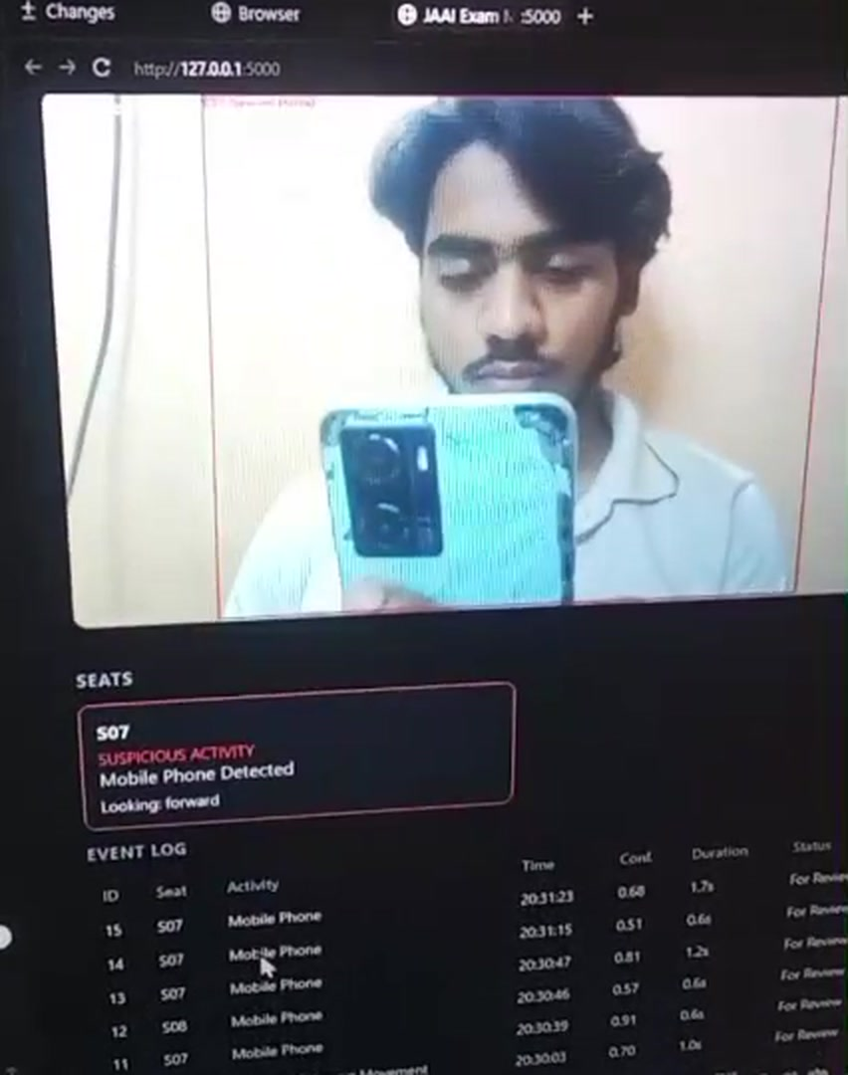
Prototype Output
Live webcam feed with the seat-wise status panel
Seat S07 flagged: Suspicious Activity, Mobile Phone Detected
Event log records ID, seat, activity, time, confidence, duration and status
Every event is marked For Review: the invigilator makes the final call
Smart Surveillance System · Major Project Phase-1 · Review-2
13

Slide 14
Conclusion
The goal is not to replace the invigilator, but to build an AI-assisted layer that continuously watches exam video and brings potentially suspicious events to the invigilator’s attention for human verification.
Phase-1 Progress
Why It Works
Working prototype on a Flask dashboard
Flags phone use and repeated sideways movement
Logs every event for post-exam review
Multi-frame evidence, not a single frame
Explainable rules layered on detection models
Human decision always retained
Smart Surveillance System · Major Project Phase-1 · Review-2
14

Slide 15
Future Scope
1
Better multi-person tracking
2
Improved behavior recognition models
3
Audio-based interaction detection, where permitted
4
Robustness across camera angles and lighting
5
Real-time notifications to invigilators
6
Automatic exam-monitoring reports
7
Integration with existing CCTV systems
8
Handling larger, crowded examination halls
Smart Surveillance System · Major Project Phase-1 · Review-2
15

Slide 16
Thank You
Team JAAI · CSE-AIML 4A · Major Project Phase-1 (Review-2)
Awais · Jameel Ali · Arif · Ibrahim

